Slide 1
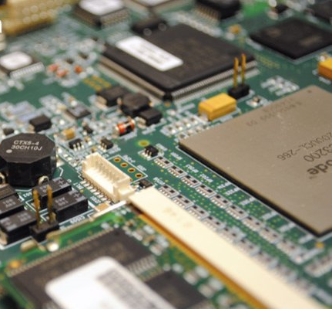
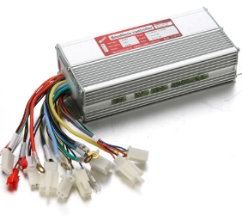
PCB
Assembly
BOX
Design
Assembly
Services

Slide 2
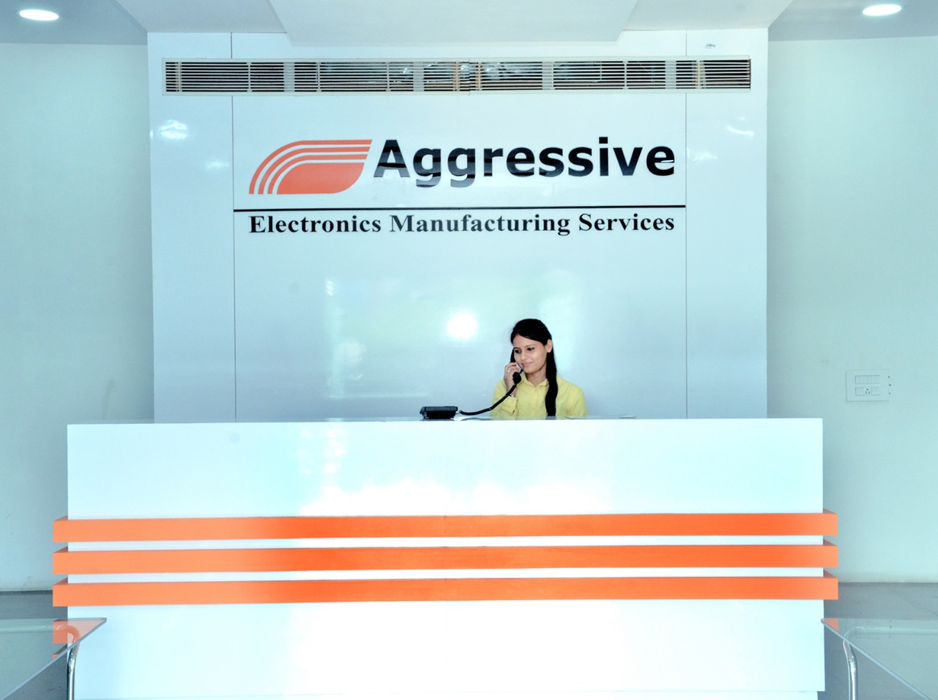
INTRODUCTION
Founded in September, 2004 to cater the needs of the growing electronics manufacturing Industry in India
AEMS is now a part of Rosy Group of Companies, a leading manufacturer of Wound Magnetic Components, having 5 manufacturing plants in NCR
The company has earned a name as one of the reliable EMS supplier in North India
Emerging player in the business of Set Top Boxes, Power Supplies, LED Drivers, LED Light
In June 2014 started an additional unit in IMT Manesar, Gurgaon for Set Top Boxes

Slide 3
COMPANY VISION
Our vision is to be an exceptional company - one that unites to enable our customers' success through technology; inspires our team to do their best everyday; and rewards investor confidence and support.

Slide 4
MISSION and GOALS
Our Mission
To be recognized as the market leader in providing Contract Electronic Manufacturing Services in specialist high technology, high reliability sectors to customers who are market leaders in their respective field
Our Goals
Continual search of innovative process to achieve excellence. Customer at top priority with focus on customer ecstasy not just satisfaction.
Developing employees and vendors as partners

Slide 5
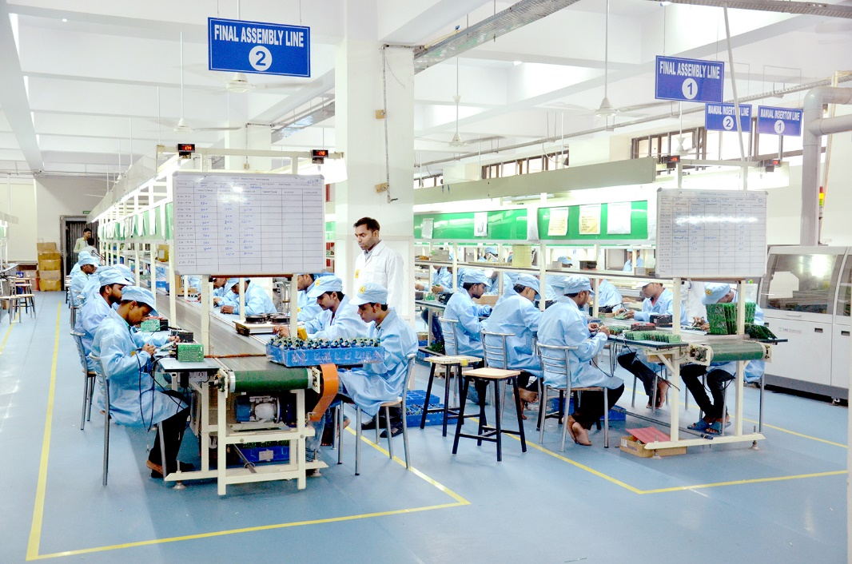
Business Focus
Manufacturing Services for Electronic Assemblies
High Density, High Complexity Circuit Card Assemblies
Integrated Box/Rack Assemblies, Complex Electronic Subassemblies & Systems
Product Development, Transition & NPI
Full Spectrum Test and Development – AOI, Visual, Functional and Burn-in
Design for Manufacturing (DFM)& Test (DFT) Services
Markets:
Instrumentation/Industrial Automation
Telecom
Automobile
Consumer Durable/Lighting
BLDC Fans

Slide 6
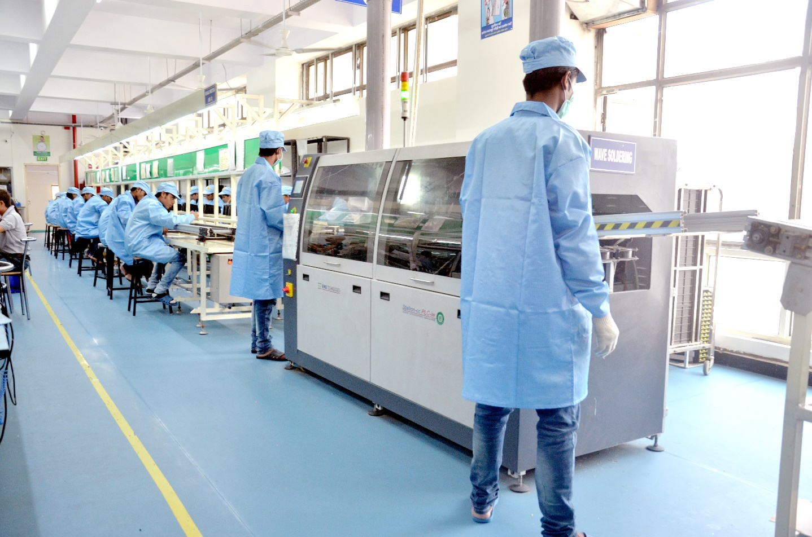
Competitive Strengths/Strategy
AEMS has developed a number of competitive strengths in the following areas:
Product Design and Development
Highly Sophisticated Engineering Capabilities
Widely-Recognized Name Brands
Advanced Manufacturing Capabilities
Technically-Sophisticated Workforce and
Extensive Intellectual Property
Financial and Operating Discipline
Our strategy:
Strengthen and expand core business
Aggressively pursue operational excellence to continuously improve margins and earnings

Slide 7
WHY AEMS ?
OUR VALUE PREPOSITION - TO DRIVE BUSINESS IMPACT
We at Aggressive are committed to develop long term partnership and are keen to generate business relationships. We have the capability to help deliver profitability, productivity and thus impacting cost and profitability
High Quality
have a proven track record of delivering high quality & cost effective manufacturing solutions
Meet Your Demand
Understands your commitment to deliver quality and meet your demand for product manufacturing
Technology & Resources
continually invests in technology,
resources & infrastructure
Skilled Human Resources
have a pool of quality and skilled human resources
Flexibility
FLEXIBLE customized solutions driven by Values, Ethics and professionalism
Scale on Demand
are financially stable, can ramp up and scale on demand

Slide 8
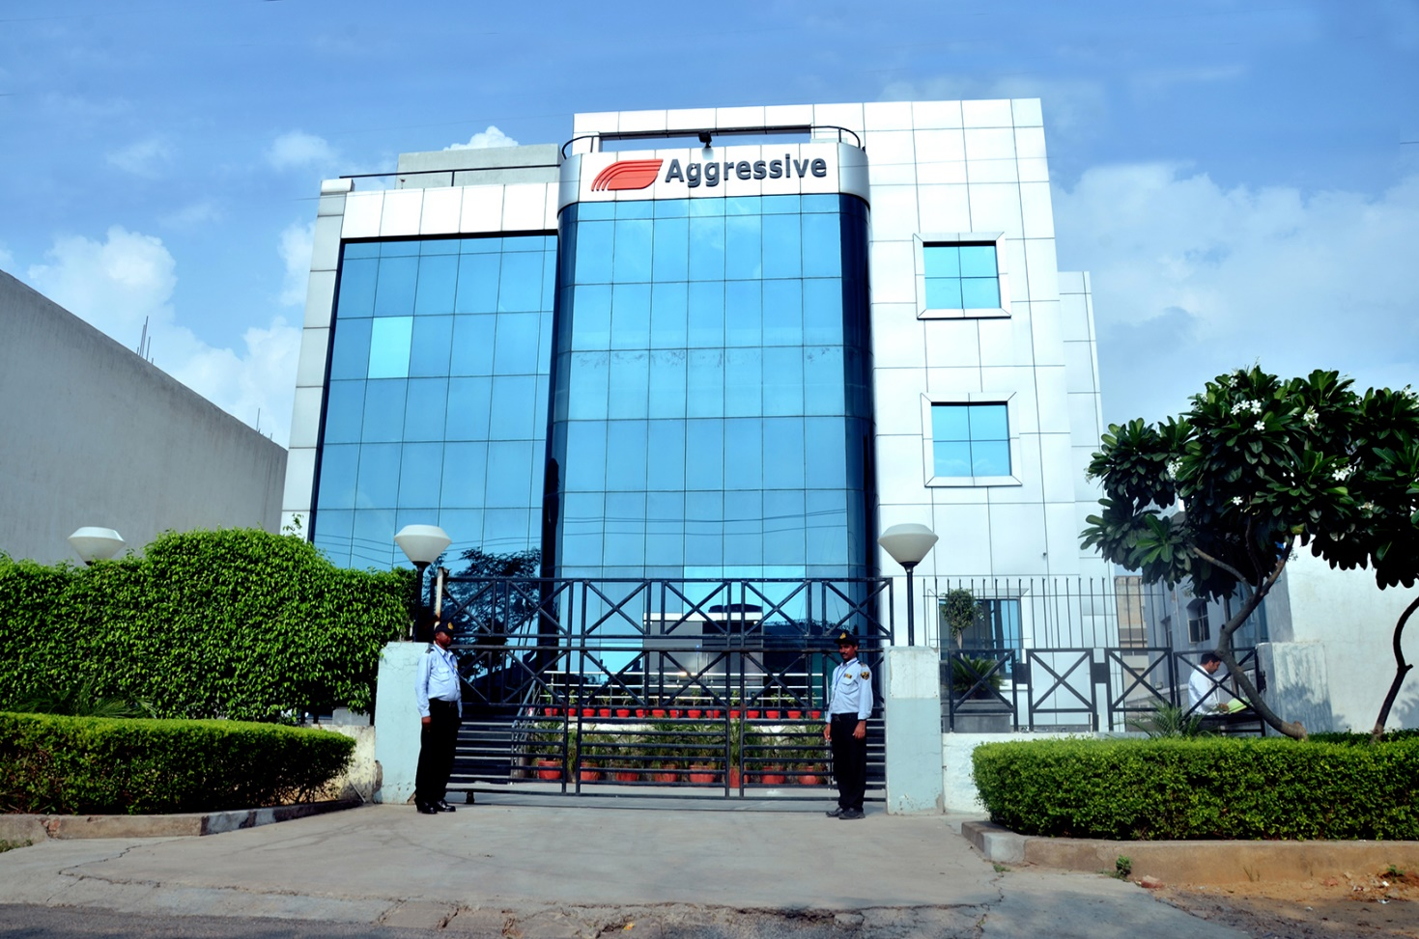
Manufacturing Facility
Over 35000 sq. ft. of environmentally controlled ESD safe work area that housed
2 state of the art latest SMT Assembly lines
4 Manual insertion lines with wave soldering
1 Selective soldering machine
4 Assembly and Testing lines
1 Packing line

Slide 9
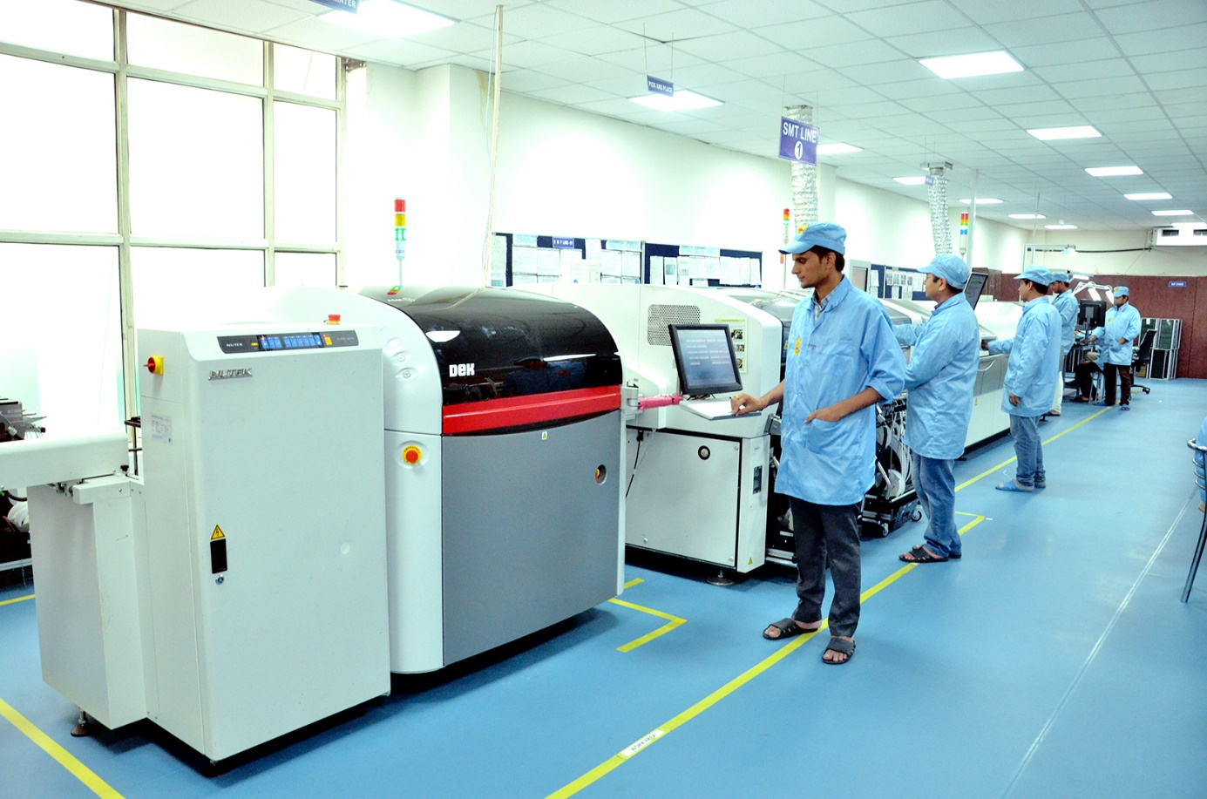
Manufacturing Capabilities
We offer a total quality solution for PCB Assembly requirements utilizing the latest manufacturing and test technology
01005 to u BGA SMT Assembly capability
SMT capacity – 200K CPH
MI capacity – 40K CPH
Max. Board Size – 450 x 550 mm
High velocity forced hot air reflow with
Nitrogen option
Programmable Selective Soldering Stations

Slide 10
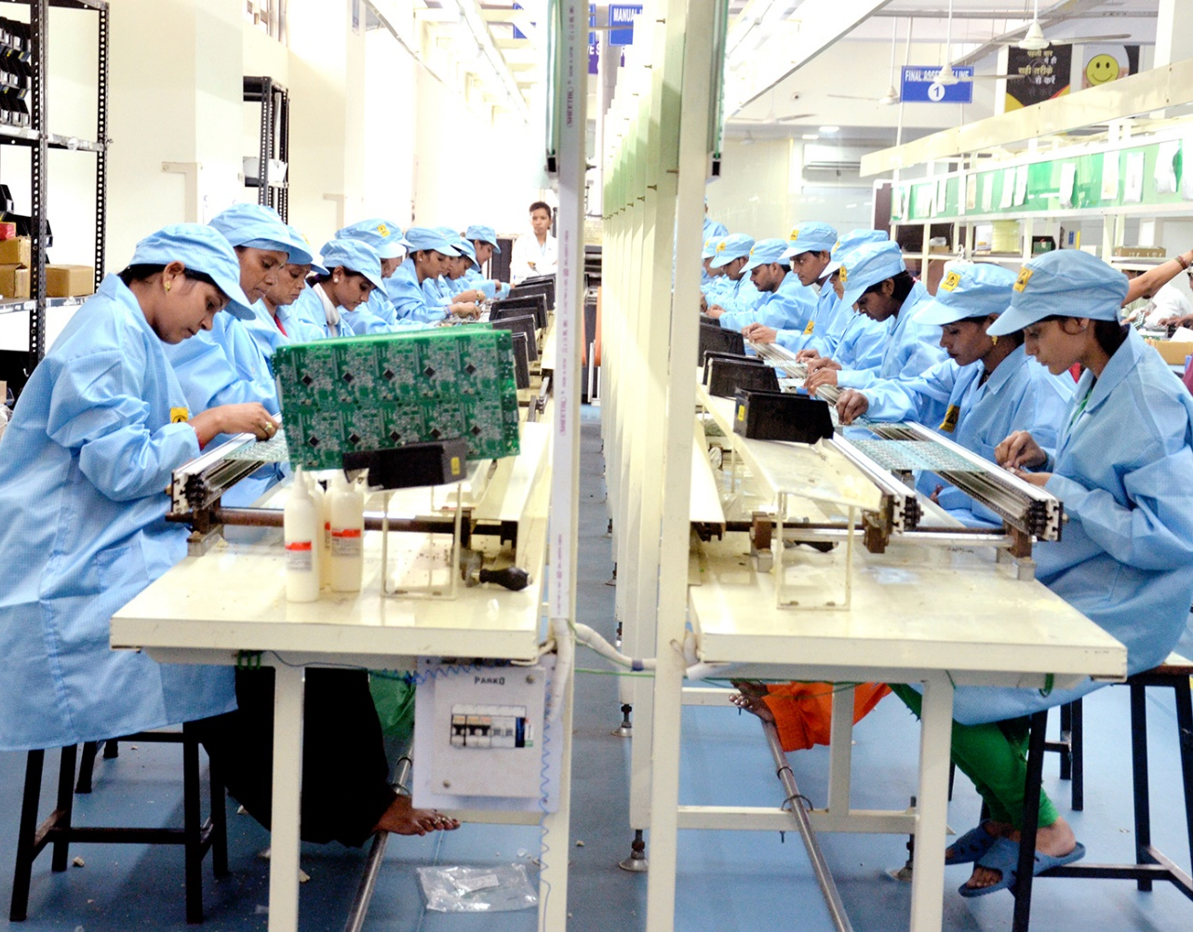
Manufacturing Capabilities
Box build and electro-mechanical assembly services (Backplane, cabinet and rack)
Press-fit connectors into PCB assemblies & Backplanes
FPGA and EPROM programming facilities
Assembly of looms, cable forms & harnesses
Front Panel, Handle and Panel Wiring
Potting, encapsulation and heat shrinking

Slide 11
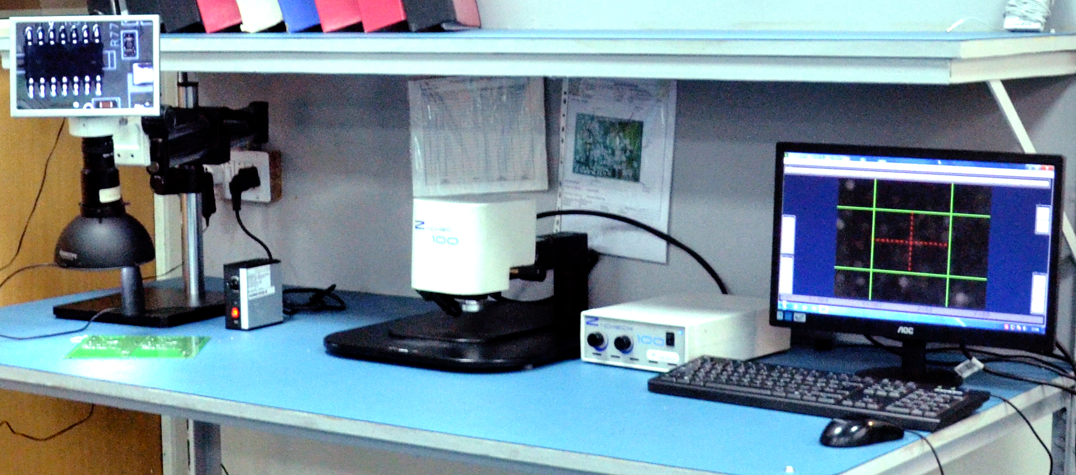
Quality Strategy & Roadmap
Our ambition
Quality is our priority in AEMS. We work
hard every day to meet and exceed customer
expectations. Our goal is to provide our
customers with the highest level of quality
excellence in the industry.
OUR STRATEGY & ROADMAP
Our quality strategy sets the directions for
reaching our goal. It defines state-of-the-art processes control for improving quality, combining innovative approaches and continuous improvement.
It is accompanied by a detailed roadmap for executing the strategy with clear ownership, timelines and resources for achieving all targets.

Slide 12
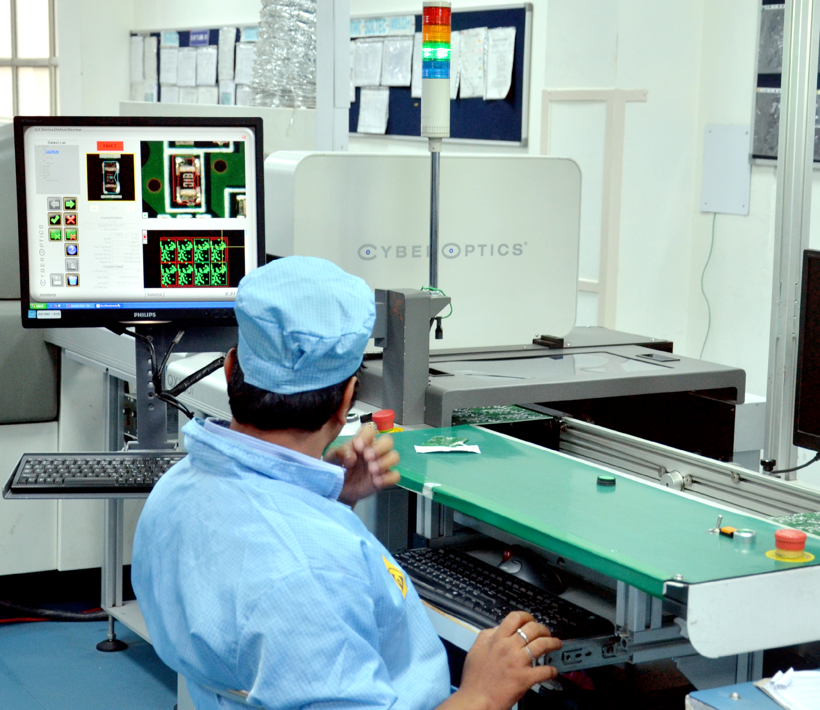
Our Quality Strategy is elaborated around 5 fundamental pillars
1. Our customers
Delight our customers by providing best-in-class quality support, communication and management of customer requirements
2. Product & technology development
Achieve built-in quality at every step of product and
technology development
3. Manufacturing & supply chain
Achieve zero excursions for our customers and
best-in-class baseline defectivity
4. People
Engage employees in the pursuit of quality excellence by
ensuring people are empowered, connected, competent
and dedicated to quality
5. Business processes, tools & indicators
Provide the quality framework for the company business model

Slide 13
PRODUCT DEVELOPMENT
Our product development process starts by identifying the customer requirements
Design controls, tests and approvals are completed at each stage of product development to ensure the robustness and reliability of the product
Product reliability is checked using
accelerated stress tests that reproduce
field stress conditions that will occur
during the product lifetime
Reliability tests are based on internal
and industry-wide knowledge of failure
mechanisms aiming to ensure that no
failure will occur during the lifetime of
a product.

Slide 14
Green Initiative
We at Aggressive EMS took a policy decision to be an ROHS Compliant company and implemented the same. Strict inspection & quality processes and procedures are being implemented to ensure ROHS Compliance
Converted all manufacturing processes Assembly lines and to ROHS Compliance
All equipment like soldering irons, consumables, etc. replaced with new ones
Non-ROHS material quarantined
ROHS Compliance Certificates from all suppliers at IGI stage
Storage space has only ROHS Compliant material
ROHS labeling / marking on all ROHS Compliant material
Finished goods have proper ROHS compliant label with Date codes
Quality Process adheres to ROHS Compliance
Eco-friendly disposition of E-waste via recognized waste management partner

Slide 15
MAJOR CUSTOMERS

Slide 16
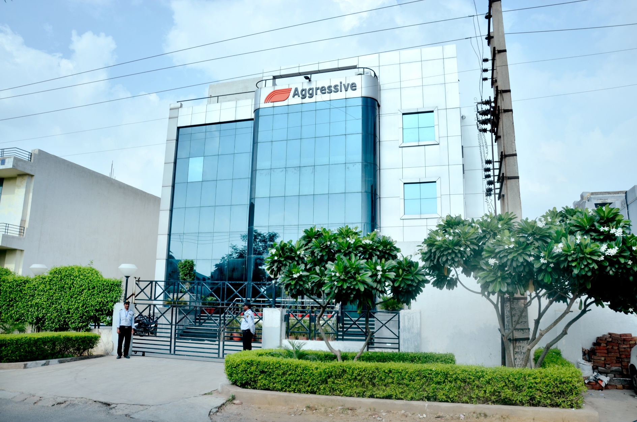
Our Official Address:- Plot No 264 Sector -6 IMT Manesar Gurgaon 122050 Haryana India Contact Mail Ids –Info@aggressiveems.com Sales@aggressiveems.com Contact No. -: 0124-4346066 9205481397

Slide 17
We are striving to a long and good partnership!
Thank you very much for your attention!

